Slide 1


Massachusetts St 14th St to 23rd St Multimodal Improvements
Public Presentation
May 22, 2024

Slide 2
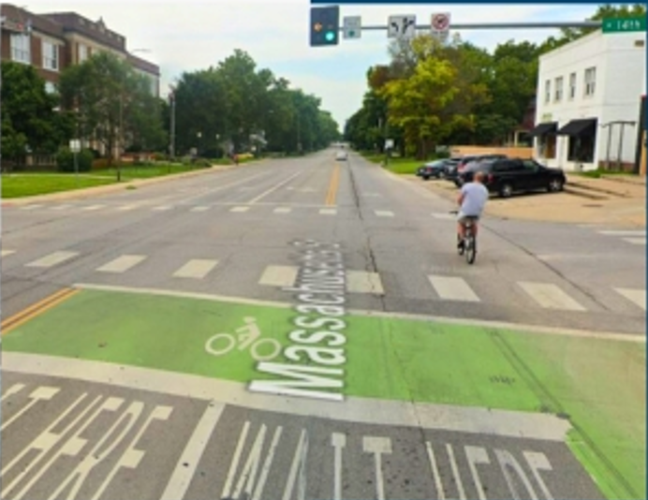

Overview
This presentation will go over the project history, findings, and next steps

Slide 3
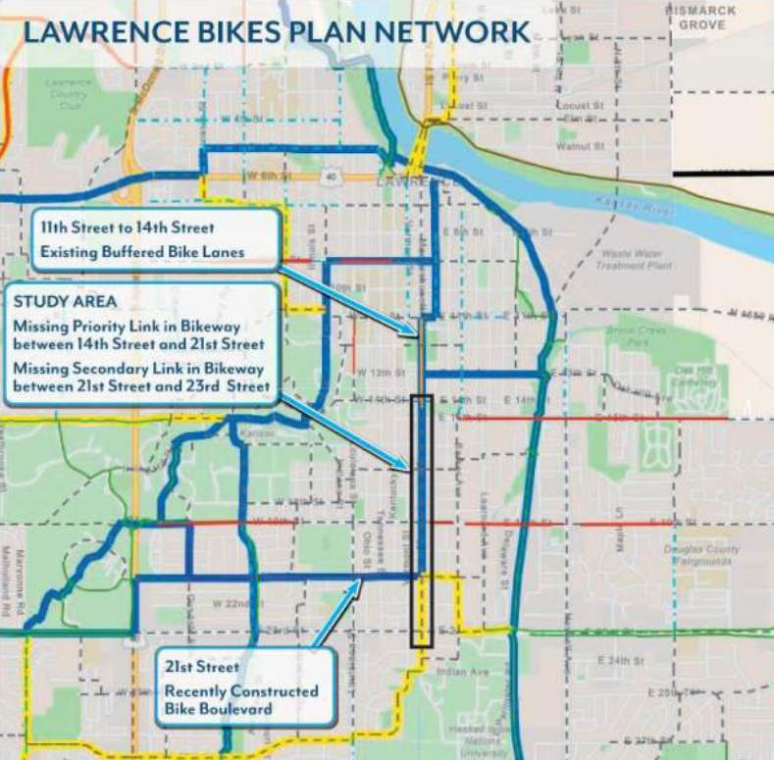


Project Impetus
Lawrence Bikes Plan
Lawrence Pedestrian Plan
Community Input
Multimodal Improvements Study
Notes:
City of Lawrence Bicycling Plan: Mass St 14th to 23rd Sts is 5 out of 5 for least comfortable for cyclists and Mass St 14th to 21st Sts is priority missing link in cycling network.
City of Lawrence Pedestrian Plan: Mass St 14th to 23rd Sts includes non-compliant sidewalk and 21st to 23rd no sidewalk. Plan calls for compliance and connectivity.
A project-specific multimodal improvements study was commissioned to include all forms of transportation including walking, rolling, cycling, transit ridership, and auto use.
Community feedback at the Involve level as project will have a significant impact and strong community interest but originates from a previously approved City plan.

Slide 4
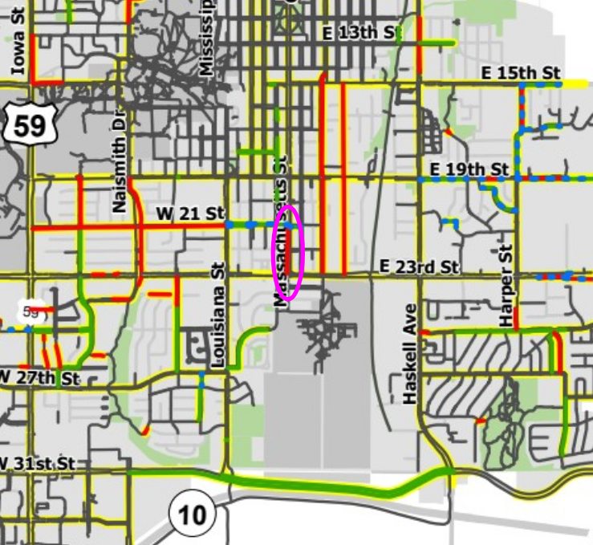
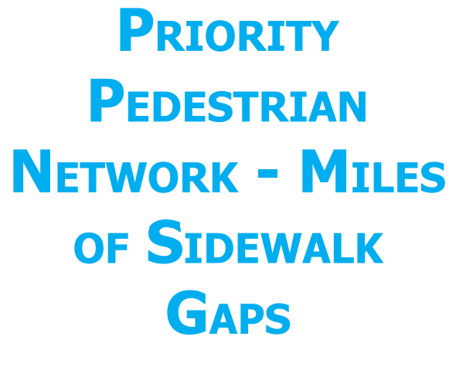
Project Impetus
Lawrence Bikes Plan
Lawrence Pedestrian Plan
Community Input
Multimodal Improvements Study
Notes:
City of Lawrence Bicycling Plan: Mass St 14th to 23rd Sts is 5 out of 5 for least comfortable for cyclists and Mass St 14th to 21st Sts is priority missing link in cycling network.
City of Lawrence Pedestrian Plan: Mass St 14th to 23rd Sts includes non-compliant sidewalk and 21st to 23rd no sidewalk. Plan calls for compliance and connectivity.
A project-specific multimodal improvements study was commissioned to include all forms of transportation including walking, rolling, cycling, transit ridership, and auto use.
Community feedback at the Involve level as project will have a significant impact and strong community interest but originates from a previously approved City plan.

Slide 5
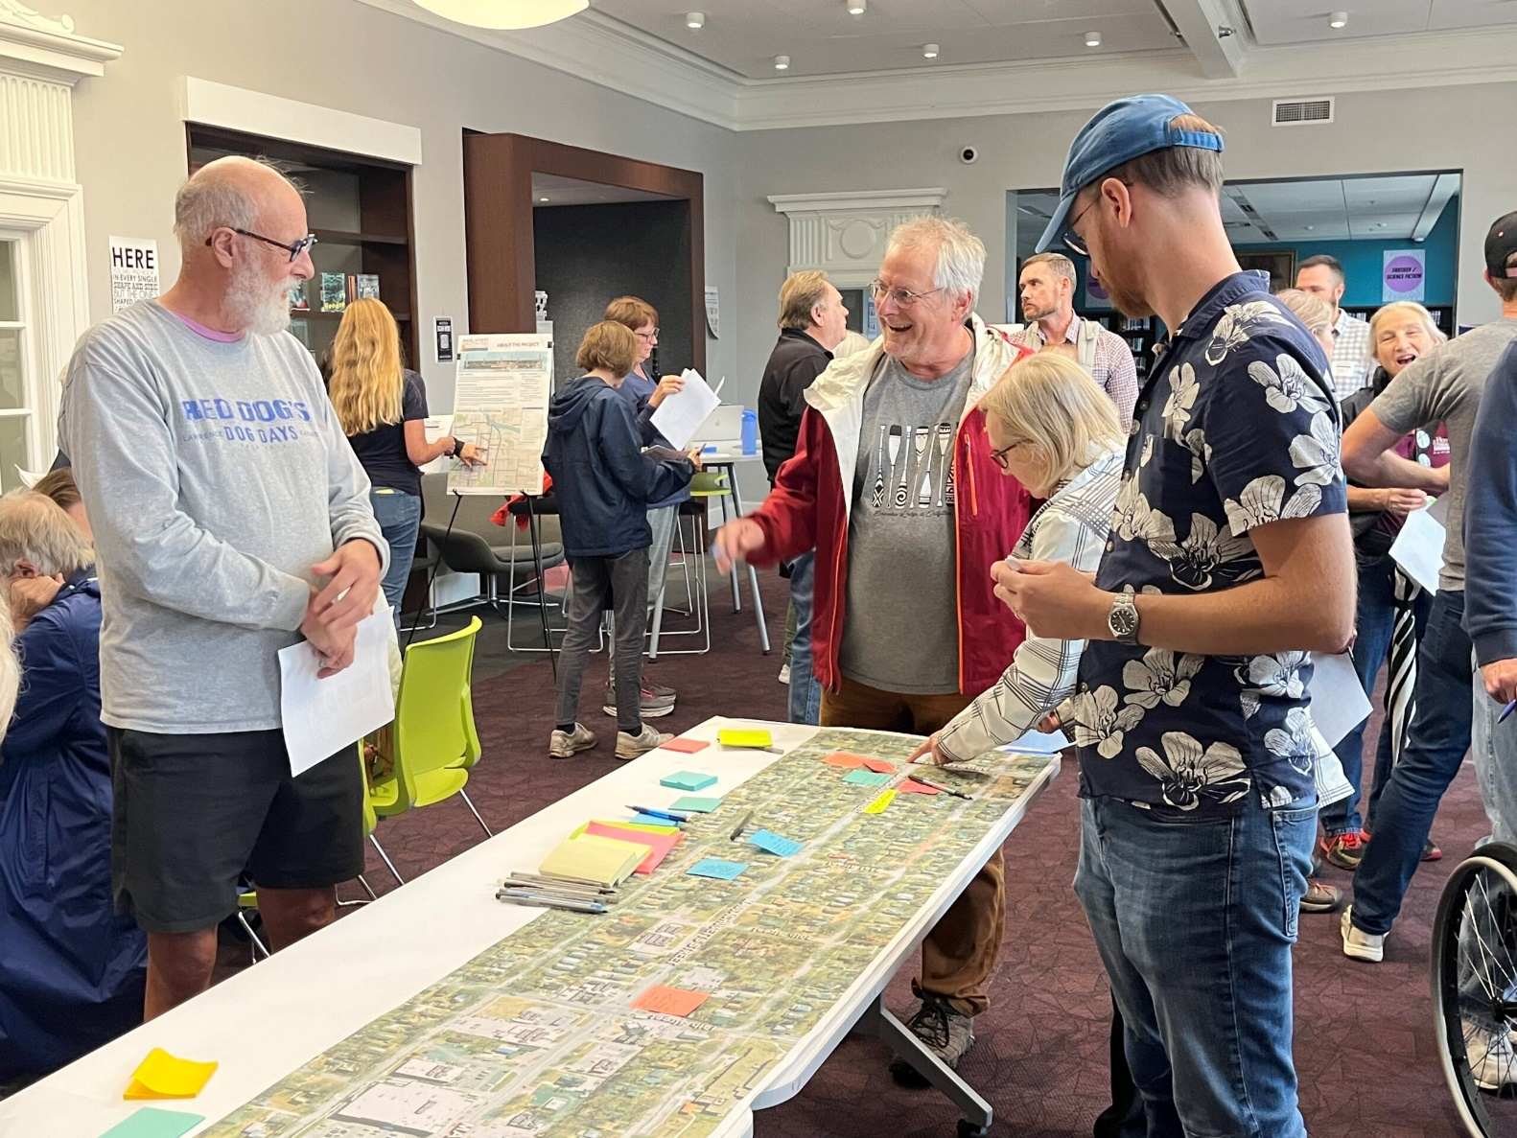
Project Impetus
Lawrence Bikes Plan
Lawrence Pedestrian Plan
Community Input
Multimodal Improvements Study
Notes:
City of Lawrence Bicycling Plan: Mass St 14th to 23rd Sts is 5 out of 5 for least comfortable for cyclists and Mass St 14th to 21st Sts is priority missing link in cycling network.
City of Lawrence Pedestrian Plan: Mass St 14th to 23rd Sts includes non-compliant sidewalk and 21st to 23rd no sidewalk. Plan calls for compliance and connectivity.
A project-specific multimodal improvements study was commissioned to include all forms of transportation including walking, rolling, cycling, transit ridership, and auto use.
Community feedback at the Involve level as project will have a significant impact and strong community interest but originates from a previously approved City plan.

Slide 6
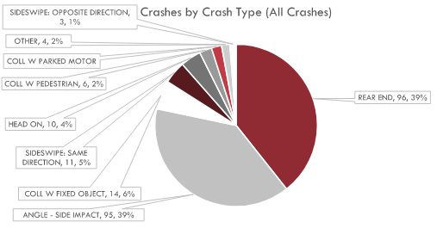
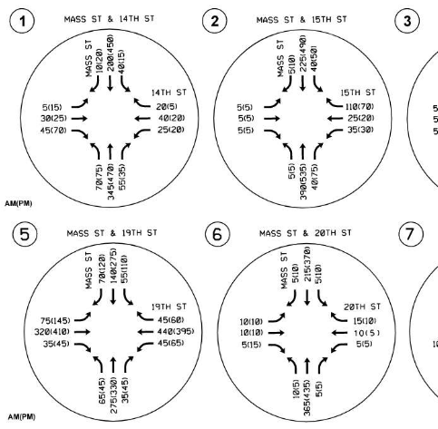
Project Impetus
Lawrence Bikes Plan
Lawrence Pedestrian Plan
Community Input
Multimodal Improvements Study
Notes:
City of Lawrence Bicycling Plan: Mass St 14th to 23rd Sts is 5 out of 5 for least comfortable for cyclists and Mass St 14th to 21st Sts is priority missing link in cycling network.
City of Lawrence Pedestrian Plan: Mass St 14th to 23rd Sts includes non-compliant sidewalk and 21st to 23rd no sidewalk. Plan calls for compliance and connectivity.
A project-specific multimodal improvements study was commissioned to include all forms of transportation including walking, rolling, cycling, transit ridership, and auto use.
Community feedback at the Involve level as project will have a significant impact and strong community interest but originates from a previously approved City plan.

Slide 7
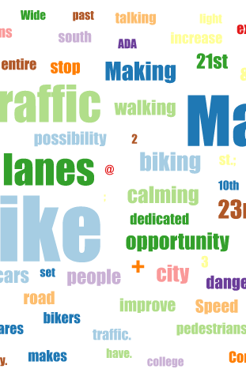

Open House #1 - October 25, 2023
72 attendee
86 survey responses
Open House #2 – February 7, 2024
Four
Community
Engagement
Events
43 attendees
72 survey responses
Open House #3 – March 27, 2024
30 attendees
4 comments received
Community Meeting – May 22, 2024
Presentation
Notes:
145 total attendees completed comment forms, posted sticky notes to strip maps, and chose preferred improvement types and profile options.

Slide 8
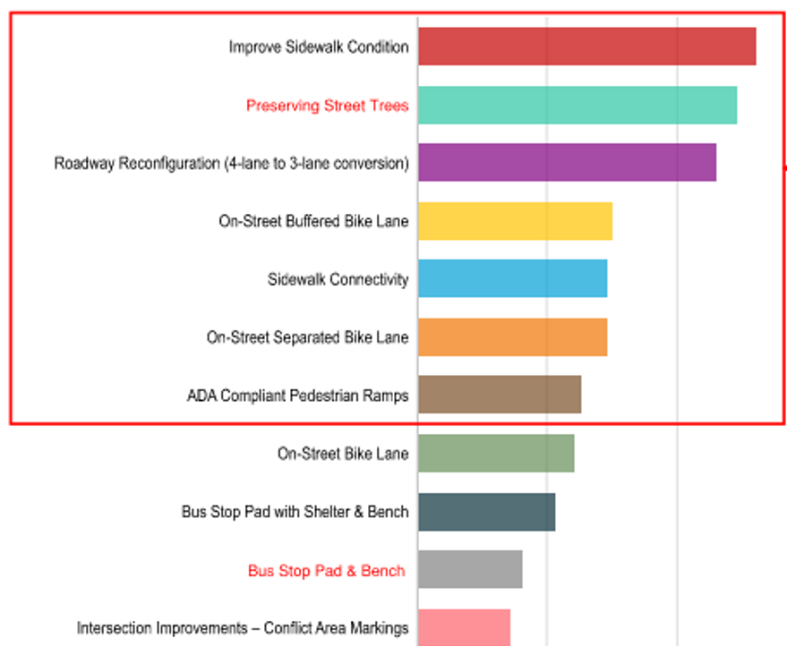
Open House #1
Top Community Priorities
Improving sidewalk and ramps
Preserving street trees
A 4-to-3-lane conversion with on-street protected bike lanes ranked highest.

Slide 9
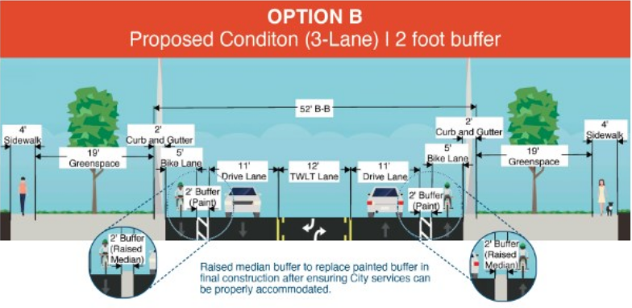

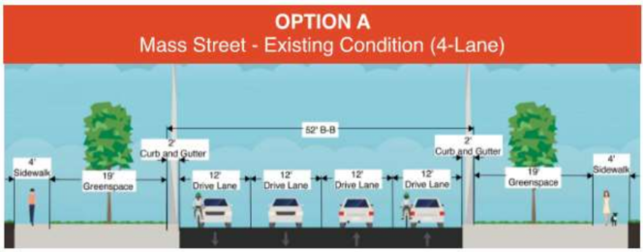

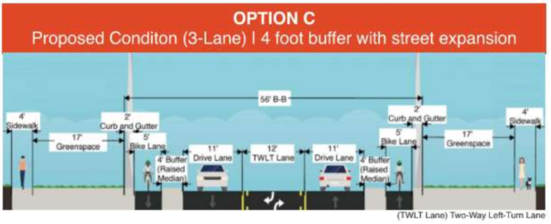
Open House #2
PREFERRED
PREFERRED OPTION
A 4-to-3-lane conversion with
on-street protected bike lanes that retained street trees
NOT PREFERRED
Retaining the existing 4-lane roadway and widening the road to better accommodate bike facilities at the expense of existing street trees.
NOT PREFERRED
NOT PREFERRED

Slide 10
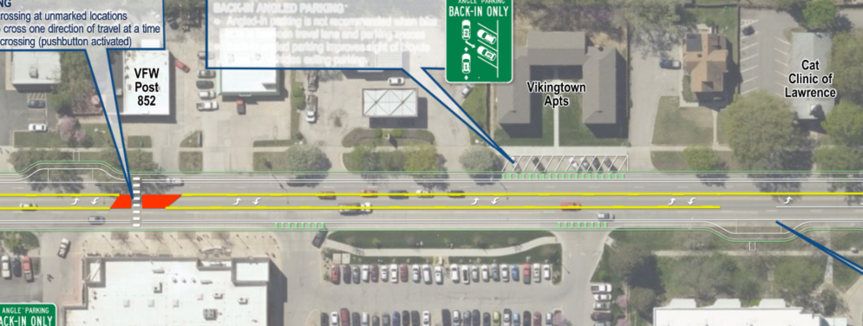
Open House #3
Pre-Design Refinement
Project background
Pros/cons
Strip map of the potential road layout.
Next steps

Slide 11
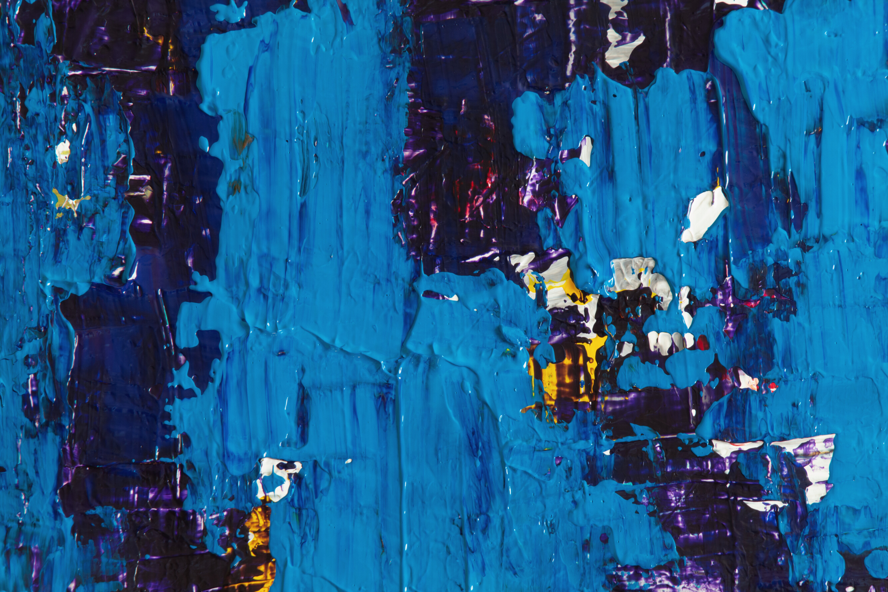
Study Recommendations
Reconfigure 4-lane road to 3-lanes with on-street buffered bike lanes (physical buffer to be studied)
Construct sidewalk along Massachusetts street between 21st St - 23rd St
Reconstruct sidewalk along Massachusetts street between 14th - 21st where not ADA compliant
Reconstruct corridor ADA ramps for compliance
Preserve street trees with no widening of Mass St
Protected intersection at 19th St and Mass St (and no roundabout)
Replace traffic signal at 17th Street intersection with HAWK signal
Remove WB high-speed right turn lane at 23rd St and Mass St
Provide mid-block crossings with RRFBs and refuge islands between 15th - 16th and 17th - 19th
Improve bus stops with floating passenger load/unload islands

Slide 12
Study Recommendations
Reconfigure 4-lane road to 3-lanes with on-street buffered bike lanes (physical buffer to be studied)
Construct sidewalk along Massachusetts street between 21st St - 23rd St
Reconstruct sidewalk along Massachusetts street between 14th - 21st where not ADA compliant
Reconstruct corridor ADA ramps for compliance
Preserve street trees with no widening of Mass St
Protected intersection at 19th St and Mass St (and no roundabout)
Replace traffic signal at 17th Street intersection with HAWK signal
Remove WB high-speed right turn lane at 23rd St and Mass St
Provide mid-block crossings with RRFBs and refuge islands between 15th - 16th and 17th - 19th
Improve bus stops with floating passenger load/unload islands

Slide 13
Study Recommendations
Reconfigure 4-lane road to 3-lanes with on-street buffered bike lanes (physical buffer to be studied)
Construct sidewalk along Massachusetts street between 21st St - 23rd St
Reconstruct sidewalk along Massachusetts street between 14th - 21st where not ADA compliant
Reconstruct corridor ADA ramps for compliance
Preserve street trees with no widening of Mass St
Protected intersection at 19th St and Mass St (and no roundabout)
Replace traffic signal at 17th Street intersection with HAWK signal
Remove WB high-speed right turn lane at 23rd St and Mass St
Provide mid-block crossings with RRFBs and refuge islands between 15th - 16th and 17th - 19th
Improve bus stops with floating passenger load/unload islands

Slide 14
Study Recommendations
Reconfigure 4-lane road to 3-lanes with on-street buffered bike lanes (physical buffer to be studied)
Construct sidewalk along Massachusetts street between 21st St - 23rd St
Reconstruct sidewalk along Massachusetts street between 14th - 21st where not ADA compliant
Reconstruct corridor ADA ramps for compliance
Preserve street trees with no widening of Mass St
Protected intersection at 19th St and Mass St (and no roundabout)
Replace traffic signal at 17th Street intersection with HAWK signal
Remove WB high-speed right turn lane at 23rd St and Mass St
Provide mid-block crossings with RRFBs and refuge islands between 15th - 16th and 17th - 19th
Improve bus stops with floating passenger load/unload islands

Slide 15
Study Recommendations
Reconfigure 4-lane road to 3-lanes with on-street buffered bike lanes (physical buffer to be studied)
Construct sidewalk along Massachusetts street between 21st St - 23rd St
Reconstruct sidewalk along Massachusetts street between 14th - 21st where not ADA compliant
Reconstruct corridor ADA ramps for compliance
Preserve street trees with no widening of Mass St
Protected intersection at 19th St and Mass St (and no roundabout)
Replace traffic signal at 17th Street intersection with HAWK signal
Remove WB high-speed right turn lane at 23rd St and Mass St
Provide mid-block crossings with RRFBs and refuge islands between 15th - 16th and 17th - 19th
Improve bus stops with floating passenger load/unload islands

Slide 16
Study Recommendations
Reconfigure 4-lane road to 3-lanes with on-street buffered bike lanes (physical buffer to be studied)
Construct sidewalk along Massachusetts street between 21st St - 23rd St
Reconstruct sidewalk along Massachusetts street between 14th - 21st where not ADA compliant
Reconstruct corridor ADA ramps for compliance
Preserve street trees with no widening of Mass St
Protected intersection at 19th St and Mass St (and no roundabout)
Replace traffic signal at 17th Street intersection with HAWK signal
Remove WB high-speed right turn lane at 23rd St and Mass St
Provide mid-block crossings with RRFBs and refuge islands between 15th - 16th and 17th - 19th
Improve bus stops with floating passenger load/unload islands

Slide 17
Study Recommendations
Reconfigure 4-lane road to 3-lanes with on-street buffered bike lanes (physical buffer to be studied)
Construct sidewalk along Massachusetts street between 21st St - 23rd St
Reconstruct sidewalk along Massachusetts street between 14th - 21st where not ADA compliant
Reconstruct corridor ADA ramps for compliance
Preserve street trees with no widening of Mass St
Protected intersection at 19th St and Mass St (and no roundabout)
Replace traffic signal at 17th Street intersection with HAWK signal
Remove WB high-speed right turn lane at 23rd St and Mass St
Provide mid-block crossings with RRFBs and refuge islands between 15th - 16th and 17th - 19th
Improve bus stops with floating passenger load/unload islands

Slide 18
Study Recommendations
Reconfigure 4-lane road to 3-lanes with on-street buffered bike lanes (physical buffer to be studied)
Construct sidewalk along Massachusetts street between 21st St - 23rd St
Reconstruct sidewalk along Massachusetts street between 14th - 21st where not ADA compliant
Reconstruct corridor ADA ramps for compliance
Preserve street trees with no widening of Mass St
Protected intersection at 19th St and Mass St (and no roundabout)
Replace traffic signal at 17th Street intersection with HAWK signal
Remove WB high-speed right turn lane at 23rd St and Mass St
Provide mid-block crossings with RRFBs and refuge islands between 15th - 16th and 17th - 19th
Improve bus stops with floating passenger load/unload islands

Slide 19
Study Recommendations
Reconfigure 4-lane road to 3-lanes with on-street buffered bike lanes (physical buffer to be studied)
Construct sidewalk along Massachusetts street between 21st St - 23rd St
Reconstruct sidewalk along Massachusetts street between 14th - 21st where not ADA compliant
Reconstruct corridor ADA ramps for compliance
Preserve street trees with no widening of Mass St
Protected intersection at 19th St and Mass St (and no roundabout)
Replace traffic signal at 17th Street intersection with HAWK signal
Remove WB high-speed right turn lane at 23rd St and Mass St
Provide mid-block crossings with RRFBs and refuge islands between 15th - 16th and 17th - 19th
Improve bus stops with floating passenger load/unload islands

Slide 20
Study Recommendations
Reconfigure 4-lane road to 3-lanes with on-street buffered bike lanes (physical buffer to be studied)
Construct sidewalk along Massachusetts street between 21st St - 23rd St
Reconstruct sidewalk along Massachusetts street between 14th - 21st where not ADA compliant
Reconstruct corridor ADA ramps for compliance
Preserve street trees with no widening of Mass St
Protected intersection at 19th St and Mass St (and no roundabout)
Replace traffic signal at 17th Street intersection with HAWK signal
Remove WB high-speed right turn lane at 23rd St and Mass St
Provide mid-block crossings with RRFBs and refuge islands between 15th - 16th and 17th - 19th
Improve bus stops with floating passenger load/unload islands

Slide 21
Study Recommendations
Reconfigure 4-lane road to 3-lanes with on-street buffered bike lanes (physical buffer to be studied)
Construct sidewalk along Massachusetts street between 21st St - 23rd St
Reconstruct sidewalk along Massachusetts street between 14th - 21st where not ADA compliant
Reconstruct corridor ADA ramps for compliance
Preserve street trees with no widening of Mass St
Protected intersection at 19th St and Mass St (and no roundabout)
Replace traffic signal at 17th Street intersection with HAWK signal
Remove WB high-speed right turn lane at 23rd St and Mass St
Provide mid-block crossings with RRFBs and refuge islands between 15th - 16th and 17th - 19th
Improve bus stops with floating passenger load/unload islands

Slide 22
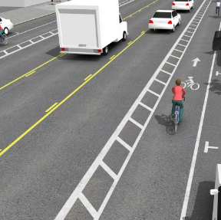
Pros
Improve bicycle facilities
Improve pedestrian facilities
Anticipated reduction in rear-end crashes
Anticipated reduction in left-turn crashes
Anticipated reduction in right-angle crashes
Fewer lanes for pedestrians to cross
Opportunity to install pedestrian refuge islands
Reduce traffic speeds
Accommodate all users
Road
Reconfiguration
Pros and Cons
Cons
Slightly increase vehicular travel times

Slide 23
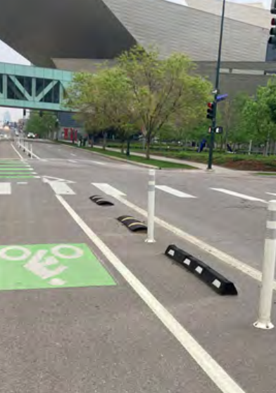
Public Meetings
MMTC Recommended approval contingent on physical bike lane protection
Staff met with the Multimodal Transportation Commission (MMTC) on April 1st to present study recommendations and feedback from community.
Staff asked that MMTC recommend the MSO department apply for grants to fund project.

Slide 24
Public Meetings
City Commission Approved contingent on staff return to discuss design details
Staff met with the City Commission on April 9th to present study recommendations and feedback from community and MMTC recommendation.
Staff asked that City Commission to recommend the MSO department apply for grants to fund project.

Slide 25
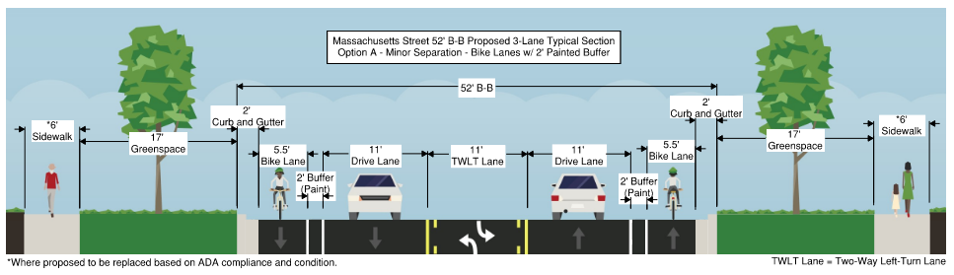
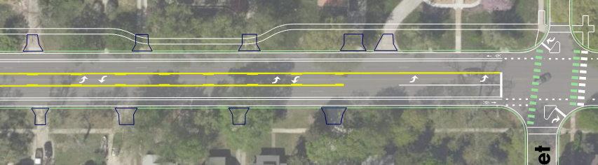
Staff response to Commission
Staff are assessing the costs and constraints for four options
Paint-buffered bike lanes on either side of Mass St.
Further Pre-Design Refinement

Slide 26
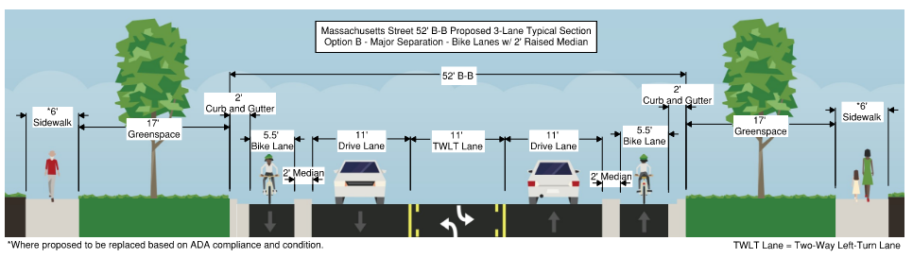
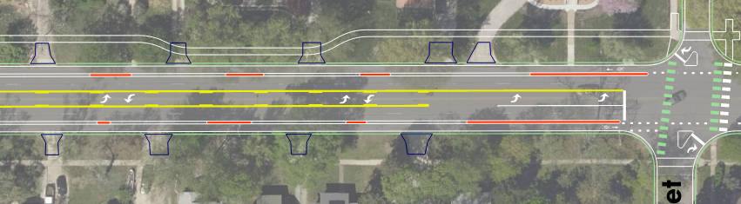
Staff response to Commission
Staff are assessing the costs and constraints for four options
2-foot-wide raised median-buffered bike lanes on either side of Mass St with medians recessed away from driveways as far as needed to pull in/pull out to collect solid waste receptacles at driveways.
Further Pre-Design Refinement

Slide 27
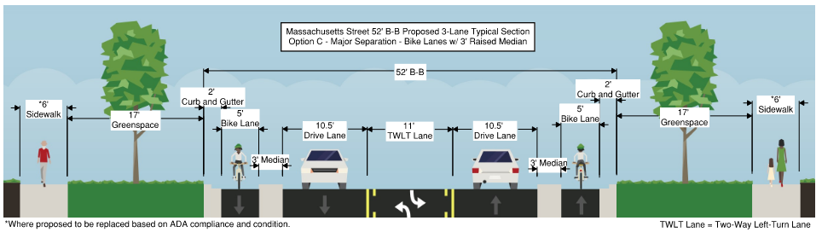
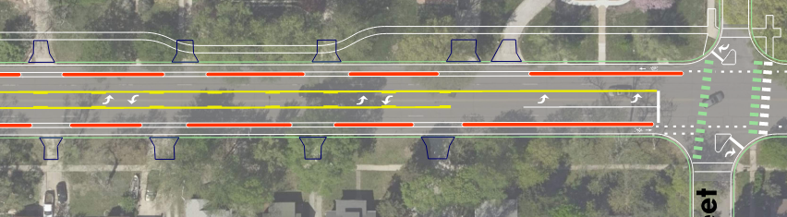
Staff response to Commission
Staff are assessing the costs and constraints for four options
3-foot-wide raised median-buffered bike lanes on either side of Mass St with placement of solid waste receptacles within the median zone for collection from the travel lane.
Further Pre-Design Refinement

Slide 28
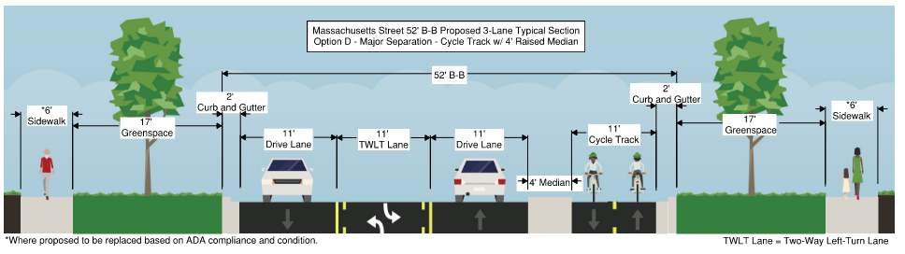
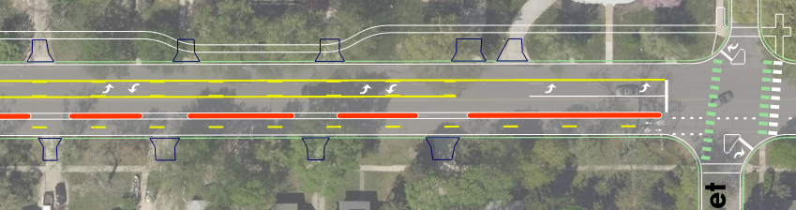
Staff response to Commission
Staff are assessing the costs and constraints for four options
Two-way cycletrack on one side of Mass St with a 4-foot-wide raised bicycle lane median with solid waste receptacles placed in the median zone for collection from the lane.
Further Pre-Design Refinement

Slide 29
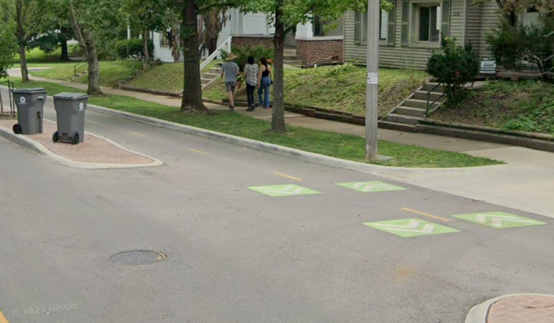
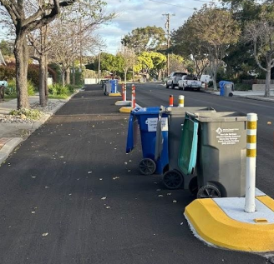
Staff response to Commission
Options 1 through 3 follow the Concept Design Study. Option 4, a cycletrack, does not but is an on-street bicycle lane facility and best meets Municipal Services and Operations (MSO) constraints.
Other jurisdictions use cycletracks as they are wide enough to be maintained with standard equipment and allow placement of waste carts in the median zone.
Further Pre-Design Refinement

Slide 30
Staff response to Commission
MSO Constraints include:
Construction funding
Debris and leaf sweeping
Snow plowing
Solid waste placement
Solid waste collection
Driveway access
Automobile/bicycle conflict points
Equipment procurement and logistics
Maintenance frequency
Personnel requirements
Curb and lane re-constructability
Flexibility for adjustment
Aesthetics
Further Pre-Design Refinement

Slide 31
Staff response to Commission
Possible MSO Recommendations and Requests:
Build protected bicycle lanes with parking blocks and vertical delineators with bike/ped funding if grant is not awarded or as a stage 1 to assess functionality before hardscaping.
Because the community asked for physical bicycle lane protection, a cycletrack would be the preferred way to meet this request for MSO Operations and Maintenance.
Additional funding to MSO for added equipment, personnel, increased maintenance frequency, and long-term added curb and road maintenance for protected bicycle lanes.
Further Pre-Design Refinement

Slide 32
Opportunities for additional public comment
MMTC: June 3, 2024
Present options and discuss constraints with MMTC seeking a recommendation
City Commission: TBD (Summer 2024)
Present options, discuss constraints, and make a recommendation seeking approval of options
Design Contract Award TBD Date
City Commission award of design contract following approved design options
Next Steps
Notes:
145 total attendees completed comment forms, posted sticky notes to strip maps, and chose preferred improvement types and profile options.

Slide 33
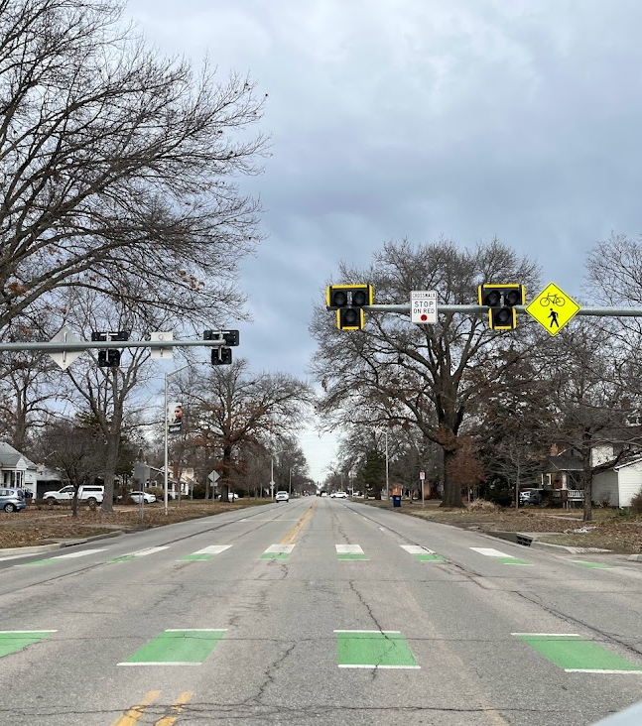

Questions?
Contact:
Aaron Parker
Senior Project Engineer
aparker@lawrenceks.org
Thank You

